Slide 1
12/04/2021
NEW ROLE SCHOOLS
DATA SCIENTIST
Edition 4 | Group 1
PROJECT WORK PRESENTATION
YOUR WAY TO THE FUTURE

Slide 2
Index | Presentation Core Structure
To adapt
Team Composition
How we worked together
Overview of the entire process and data insights obtained from it
Business action proposals based on findings
2

Slide 3
Group 1 composition & how we worked together
Adapt roles
ADD PROFILE
PICTURE
ADD PROFILE
PICTURE
ADD PROFILE
PICTURE
ADD PROFILE
PICTURE
ADD PROFILE
PICTURE
ADD PROFILE
PICTURE
Sebastián Catalán Fuica
Role
Afp Planvital Chile
Floriane Hernalsteens
Role
Europ Assistance Belgium
Roman Hospodár
Role
Generali Czech Republic
Oliver Manara
Role
Generali Germany
Federico Sportelli
Role
Generali Italy
Lee Thompson
Role
Generali UK
Weekly team meetings (1x or 2x a week)
Teams channel, Github repository & Whatsapp group
Work division according to level of expertise & interest
3

Slide 4

The Use Case
«How to increase the customer retention for a travel agency»
What is the situation?
our group consults an agency which provides school-trips (of various grades/school types & sorts of travel)
our aim is to increase the percentage of trips which are rebooked in the following year by finding insights in historic data & defining applicably actions to increase the customer loyalty
Our Approach
we build a modell using statistical methods to predict the probability of a school booking again a trip based on the behavior of similar clients in the past
assembling on the forecast we figure out the positive and negative key drivers & derive actions to increase the retention
4

Slide 5
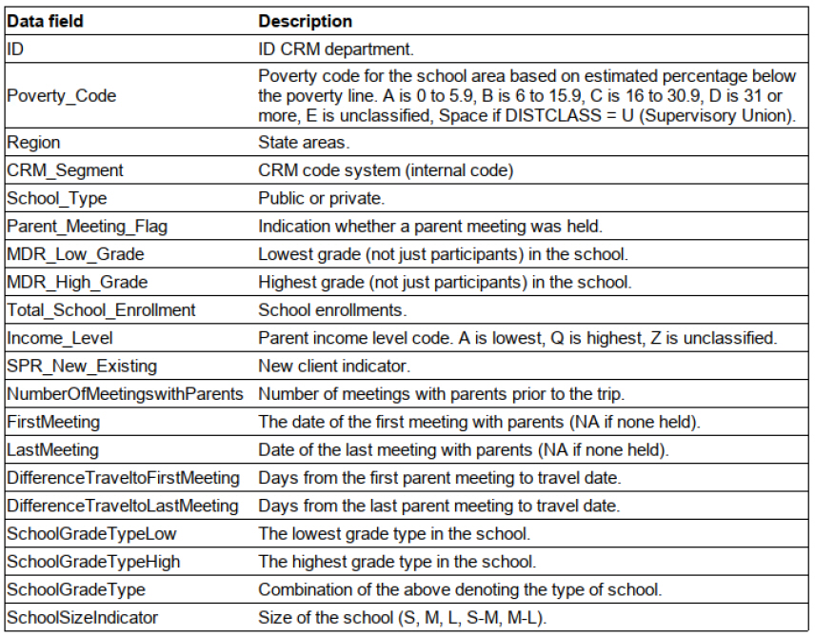
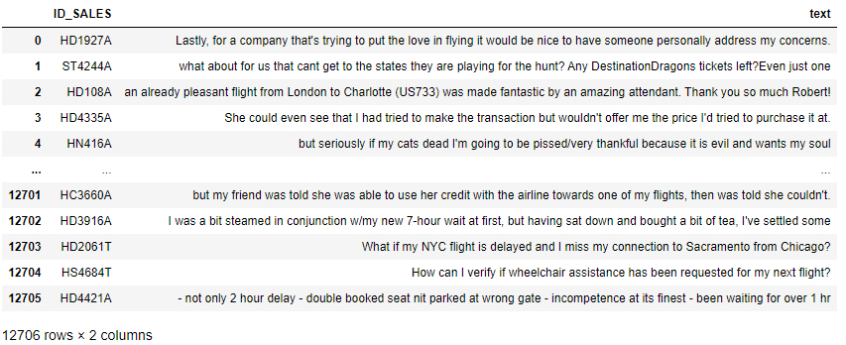
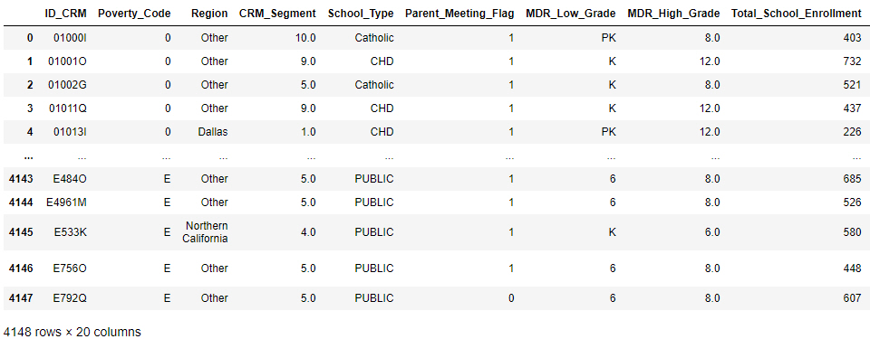
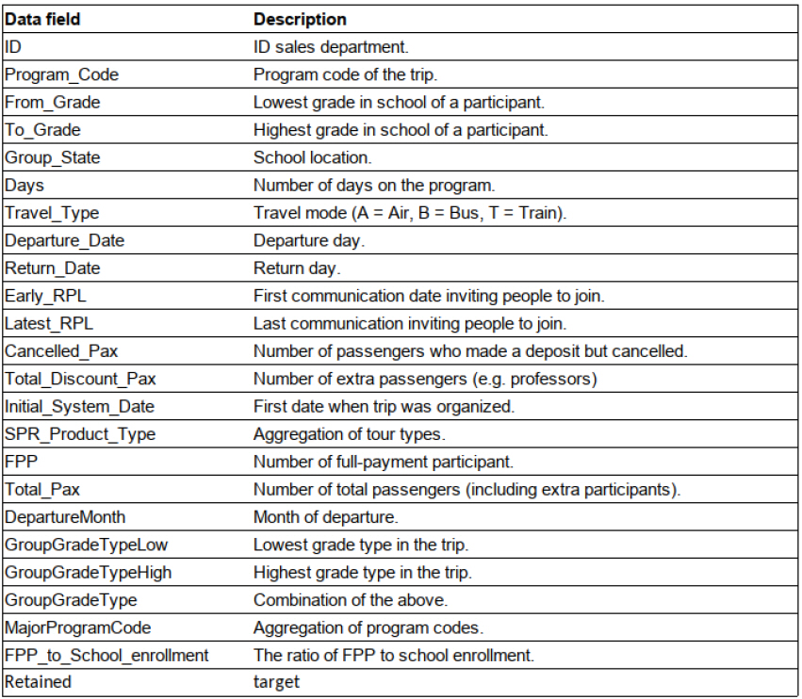
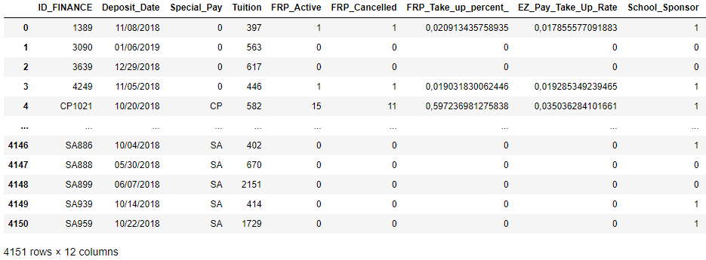
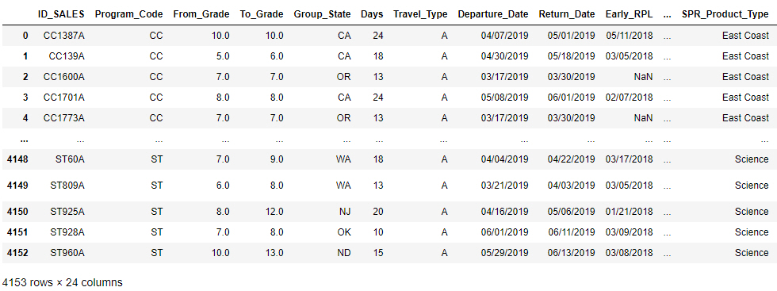
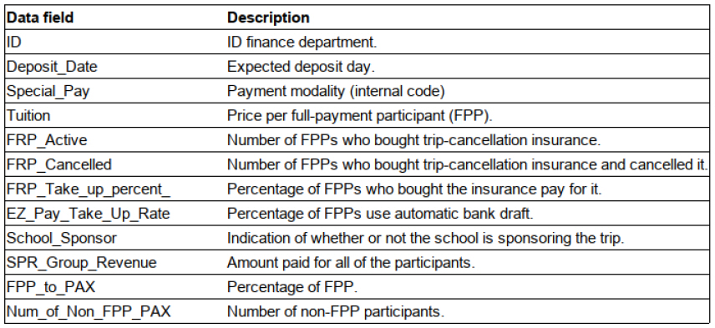
The Use Case four data sources can be analyzed
Tweets of customers refering to trips
CRM Customerdescription based on Customer relationship system
Sales Tripspecification & target variable „Retained“ (1, 0)
Finance Billinginformation
5

Slide 6
Data Quality Observations
Prior to creating a model a data quality assessment was made to identify any potential issues which could drastically impact the accuracy of the predictive model.
Error Types
Missing Values
Sequential Date Inconsistencies
Data Contradictions
Non-reconciliations
Corrective Assumptions
Population of missing values
Apply logic to dates
Take the latest capture to be true
Recalculate fields that can be derived from other fields
Each of the applied cleansing assumptions required mostly impacted 10s of rows, it is considered that these changes would not alter the overall shape of the data or its representation.
Setting a blank field to the mean has a minimal impact on the representation of that data, but is an important assumption to make as it allows the model to leverage on the other fields within that event where the data is reliable, which is not possible if a whole record is deleted due to one missing value.
6

Slide 7
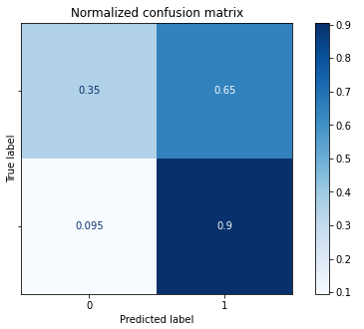
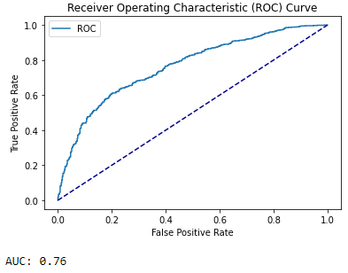
Draft
Our Path to Model Creation
1
After merging the datasets and doing a quick preprocessing, we trained a simple logistic regression model in order to have a reference score to improve.
Starting ML Model’s performance (f1-score ~77%):
7

Slide 8
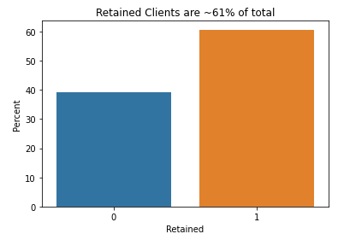
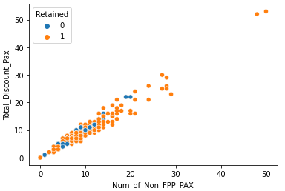
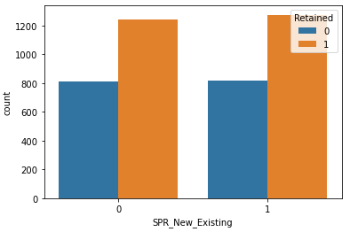
Draft
Our Path to Model Creation
2
Next step was to look deeply into the data:
We perform data exploration running statistical analysis and visualizing the data. In this phase we noticed for example that data was slightly imbalanced but not so much to require the use of particular techniques.
We also noted that some features were correlated with each other, redundant or not useful.
Class Frequencies:
Example of correlated variables:
Example of a useless variable:
8

Slide 9
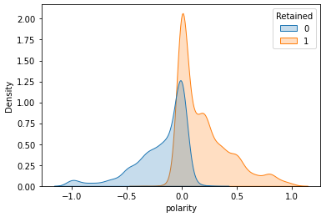
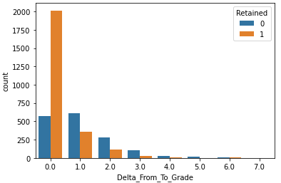
Draft
Our Path to Model Creation
3
We then played with the variables trying to create others. In particular, we focused on the dates, number and classes of origin of the participants in the trip. In doing so, we found a variable- (Delta_From_To_Grade), which allowed us to increase the quality of the prediction.
The turning point came when we examined the tweets that we had initially left out, introducing the sentiment analysis in our model.
The interpretation of both of this features will be explored later.
New variables:
9

Slide 10
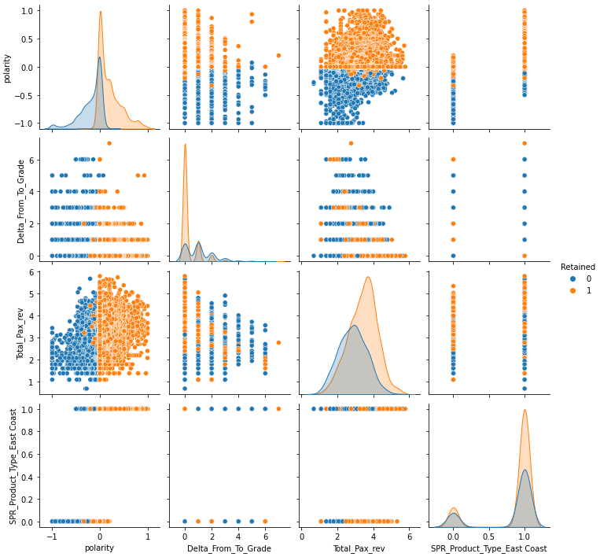
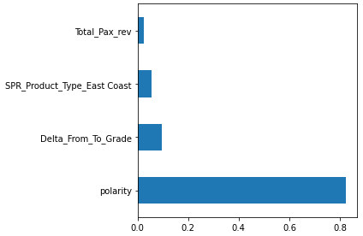
Draft
Our Path to Model Creation
4
At this point, to simplify the model, we began to reduce the number of features (we had reached over 200), trying to keep only the most significant ones. To do this we used the classic feature selection techniques (Chi-Square and F tests, Lasso regression) and our common sense.
Polarity does a good job identifying retained clients:
Most important features:
10

Slide 11
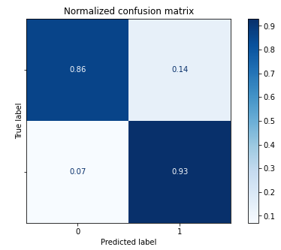
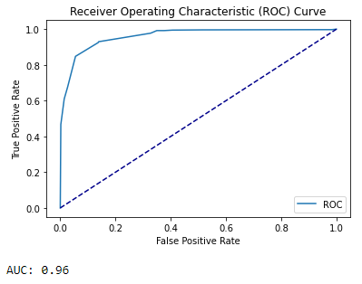
Draft
Our Path to Model Creation
5
The last step was to train different models (Decision Tree, Random Forest, AdaBoost ...) using only the most important features. We obtained excellent scores - f1 over 90% - with all the models.
At this point, instead of trying to obtain marginal improvements by overcomplicating the model, we preferred to opt for the simplest one, a classification tree, focusing our minds on business proposals.
Final ML Model’s performance (f1-score ~92%):
11

Slide 12
Polarity
It is the measure of the process of analyzing the sentiment of each tweet into negative, neutral or positive. This measure ranges from -1 to 1
Text cleaning
Remove mentions
Remove hashtag
Remove retweet
Remove hyperlink
Remove all distinct to words (ex: emoticons)
How do we calculate the polarity by id?
Calculate sentiment for each tweet using TextBlob
Mean of polarity by id (ID_SALES)
Fill null values with the mean sentiment

Slide 13
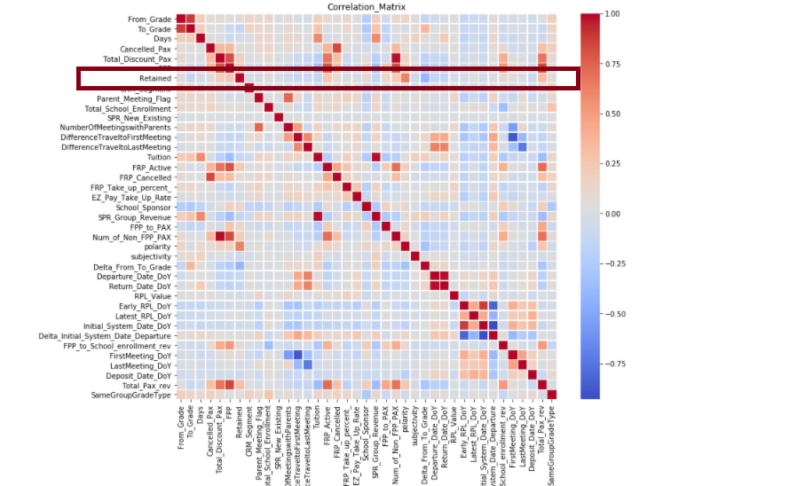
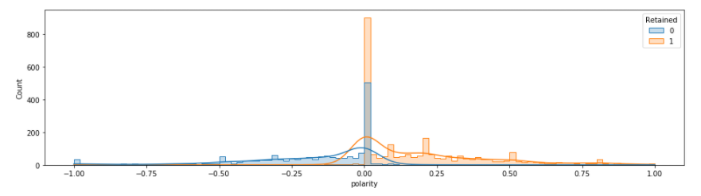
Polarity vs Retention
13

Slide 14
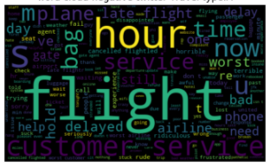
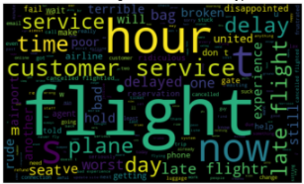
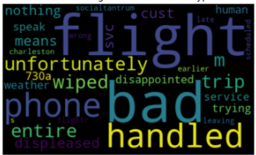
To revise wordcloud?
Polarity
Travel mode: Air
Travel mode: Train
Travel mode: Bus
Late flights
Customer service
Problems with bags
14

Slide 15


Business action proposals based on findings
Polarity is a key predictor
Word of mouth
Send out a survey (NPS) after each trip to assess customer satisfaction level on different aspects of the trip
Use quantitative (scores) and qualitative (comments) feedback to predict the retention for that trip & school
Set-up a governance to periodically analyze NPS results : identify areas of excellence and improvement and deduct concrete actions
Sponsor „a friend“
The school can invite another school to sign up for a new trip. If it does, they will get a discount of 10% on next subscription
Work with ambassadors
Ask the best scoring NPS if they want to testify about their experience and use it on your website

Slide 16


Business action proposals based on findings
Area for improvements
Feedback collection pitfalls
„Close the loop“ for the detractors by calling all low scores to voice out their experience in order to gain more insight and for the customer to feel heard (phone number should be a mandatory field at subscription)
Feedback on flights
Audit the different airlines in portfolio - with a focus on flight punctuality, flight cancellation, luggage management & customer service excellence
Only partner with best ones
In case of long waiting times in airport, always have a playful (group) activity prepared, that is adapted to the age group
In real life, tweets cannot easily be linked to a specific trip
GDPR and data privacy
NPS survey is linked to specific trip and not anonymous

Slide 17
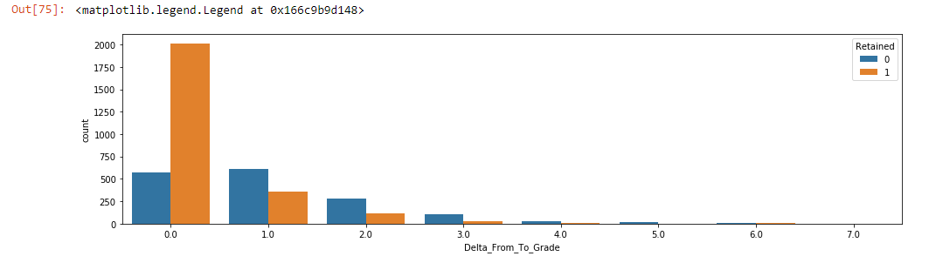
Delta_From_To_Grade
We have introduced to dataset newly created parameter as combination of
To_Grade
From_Grade
Delta_From_To_Grade = From_Grade - To_Grade
Thanks to this new parameter, retained explanation increased to 80%.
17

Slide 18
Delta_From_To_Grade
Finding:
The level of overall satisfaction and retain factor for the trip is higher, when there are homogeneous groups of students attending.
Rationale:
We suppose it is due to the fact, that it might be much easier to fulfill the expectations and entertain the homogenous group with similar interests by certain set of activities.
Heterogeneous group (students of multiple grades) can have different interests, also some activities are not suited for multiple age groups
It might be much harder to find such activities suited for wider age range of people

Slide 19
Product Types – East Coast
We have observed a significant driver to retention to be the selection of the East Coast product.
CA History is by far the most popular product but not among the key drivers if regarded in combination with the other factors. Thus, it is recommended to broaden this product for trial and monitor it’s impact
Underperformers:
Costa Rica
International
It is noteworthy that the volume for these products are much lower
Than others, and could be considered too small to analyse, however
It is unlikely that with a larger sample size the retention rate for
International would increase from 7% to that of the better
performers.
Product | Sales | Retained | Lapsed
CA History | 319 | 70% | 30%
Costa Rica | 76 | 28% | 72%
East Coast | 3,465 | 62% | 38%
IL History | 8 | 63% | 38%
International | 29 | 7% | 93%
Science | 251 | 44% | 56%
This one way analysis is more rudimentary than the predictive model but is shown here for ease of understanding.
Business Recommendations: Where possible focus marketing on the East Coast product and offer incentives for selecting this product with the aim of increasing long term retention and therefore LTV. Undertake a review of the International and Costa Rica offerings.
19

Slide 20
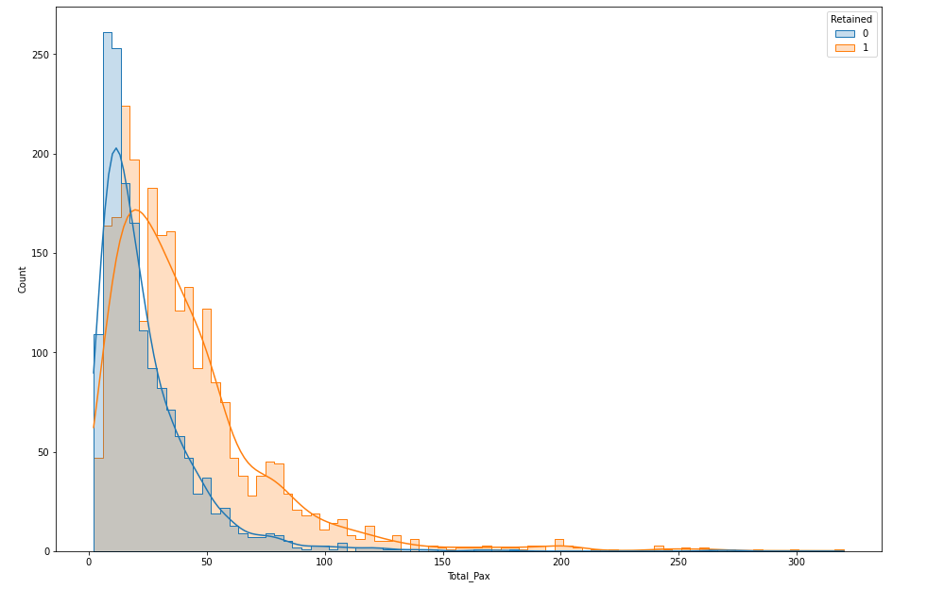
Total Number of Passengers
Pivotal Passenger Sizes
< 10 Largely not retained
Crossover Point: ~25 Passengers
> 25 sees a large increase in the retained percentage
Regarding the insights of 'Delta_From_To_Grade,
the group size must not be increased in any case but
but has to ensure the homogenity of age
Business Recommendations: Take actions to increase the group size without increasing the homogeneity of the age groups. Promising measures are incentivising larger groups by giving a discount and merging several groups of the same age.
20

Slide 21
Improving Data Quality and Value Add from Data
We have seen that with the already data collected, value can be derived that can support data driven decisions with the aim of increasing top line revenues.
The value that can be derived from data is linked to the detail and quality of the data, therefore it is advised to invest further in the data capture systems and data cleansing processes.
Data Input
Implement mandatory fields
Enable dropdown selections for defined categories
Reduce “free text” inputs where appropriate
e.g. pop-out calendars for date selections
Post-Input Data Quality Checks
Data Type Checks
e.g. Dates are correctly formatted
Automated Logic Tests to identify errors in data input, feedback loop to correct errors.
e.g. Flag when the last meeting date is before the first meeting date
The cleaner the data, the more accurately models can represent the mechanics of your business, and therefore improve the insights that can be derived from your data.
It could also be beneficial to capture additional fields in systems, along with creating new data streams (e.g. NPS) as these could also lead to additional insights from the analysis.
21

Slide 22
Key take aways – to adapt

Slide 23
Q&A
Thank you!

